Slide 1


STAT 350 Lab
TA: Zhou Shen

Slide 2
Group portion
This lab has individual and group parts
Everyone submits a file for the individual part
Only one file is submitted per group
CLEARLY MARK GROUP MEMBERS AND TIMES IN FILE
I grade the submission, then find all group members and manually populate their scores

Slide 3
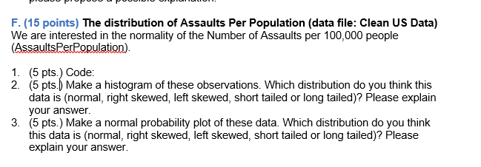
Don’t forget question F

Slide 4


Forming Groups
Group members MUST have the same instructor,
Do not need to be in same section
Group size is 3 to 5
Piazza is a tool to make groups, Google Doc for collaboration

Slide 5
This lab:
Look at histogram and QQ plot for different shapes of distributions
Normal
Skewed
Long/Short tailed
Learn to assess normality from plots

Slide 6
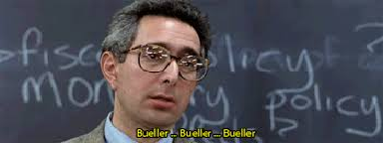
Why do we care about normality?

Slide 7


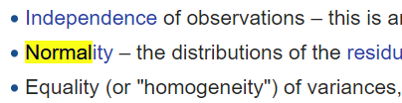
Tests rely on it

Slide 8
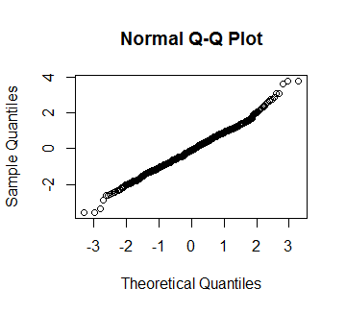
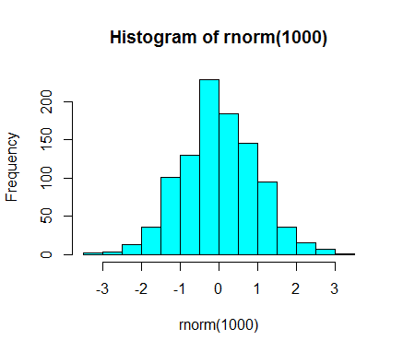
So we need to know how to check

Slide 9
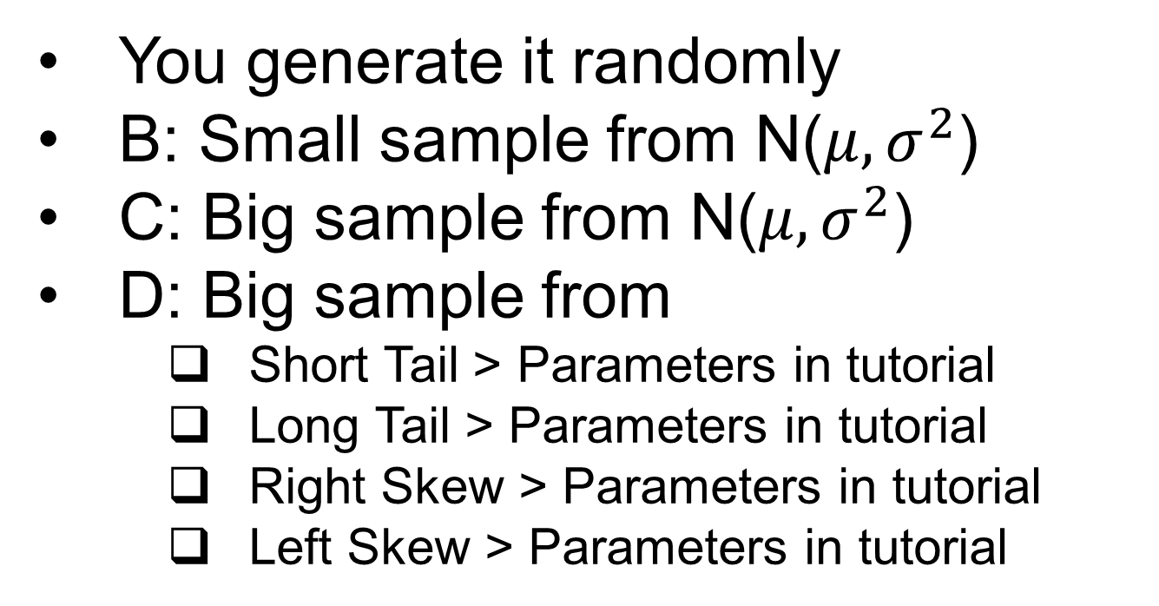
Data this week

Slide 10
What to comment on
Deviations from normality?
If so, point out specifics
Left skew or right skew?
Long or short tails
Describe in your own words
Do this for BOTH the histogram and QQ plot

Slide 11
Tutorial Code
For Part D: Only the functions to generate random numbers from each distribution are included.
You will need to incorporate them into your code using Part C as a template.

Slide 12

APPENDIX
INCLUDE YOUR DATA!

